Slide 1
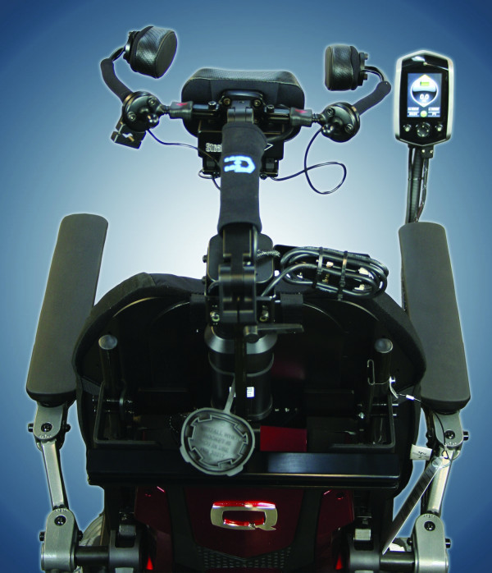
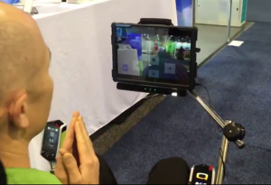
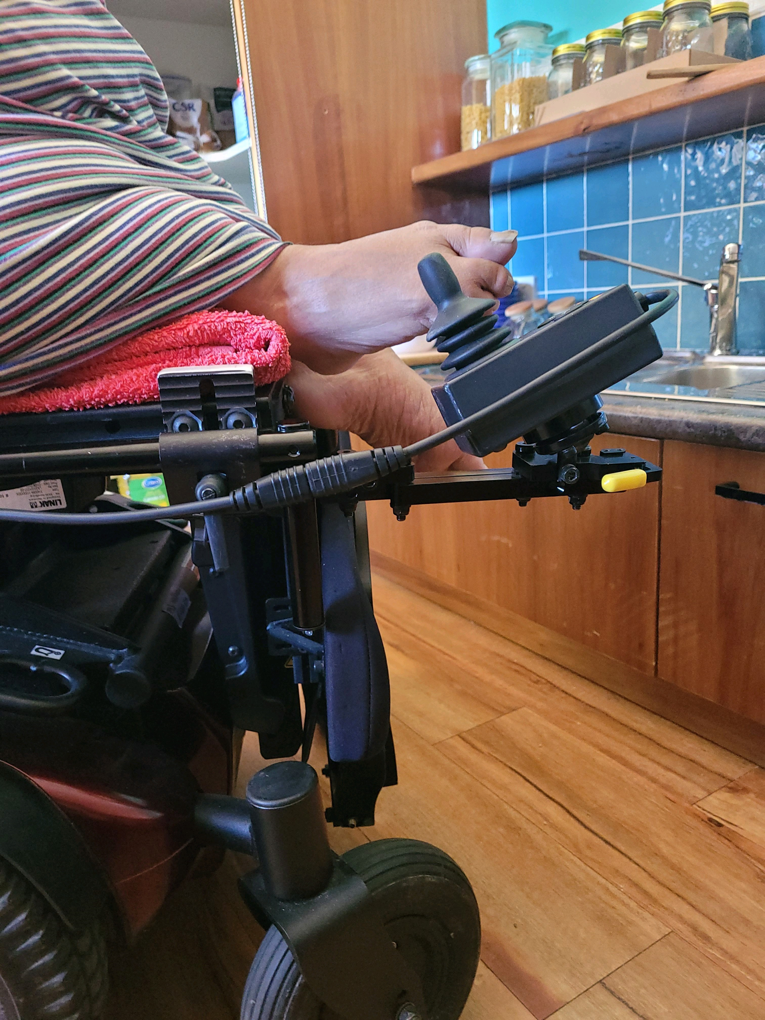
Alternative Power Controls Workshop
Presented by Lauren Hunter,
OT Clinical Educator and Product consultant with
Linds Rehabilitation Equipment
Lauren@lindsrehab.com.au

Slide 2
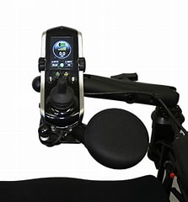
Learning Objectives:
• Learn hands-on assessment techniques and physical considerations to support the choice of controls
• Discover the vast range of alternative drive controls available including eye tracking and eye control - a technology that makes it possible for computers to know exactly where users are looking. When eye tracking and eye control are combined with speech generating devices, communication opportunities are enabled for individuals with special needs, including those with Motor Neuron Disease (MND), Cerebral Palsy, Rett Syndrome, Spinal Cord Injury, Multiple Sclerosis and Stroke/Aphasia
• Understand their points of difference in a clinical sense and considerations for application
• And most importantly, try them for yourself!

Slide 3
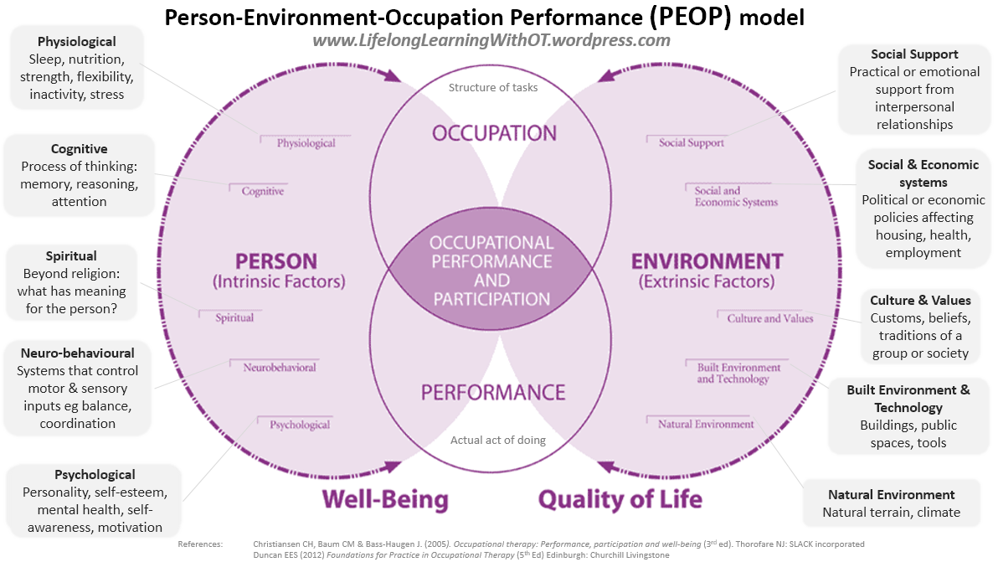
Building your client profile
Standard comprehensive occupational therapy assessment will explore the intrinsic/extrinsic factors to identify occupational performance issues for individuals within our models of theory. This allows us to produce a client profile.

Slide 4
Systematic Assessment Process
Initial assessments that lead to identifying occupational
performance issues: Creating a Client Profile
Wheelchair specific proforma
Pressure risk tools
MAT (mechanical assessment tool) evaluation/ physical mapping
Cognitive screen
Sensory Profile
Wheelchair skill specific

Slide 5
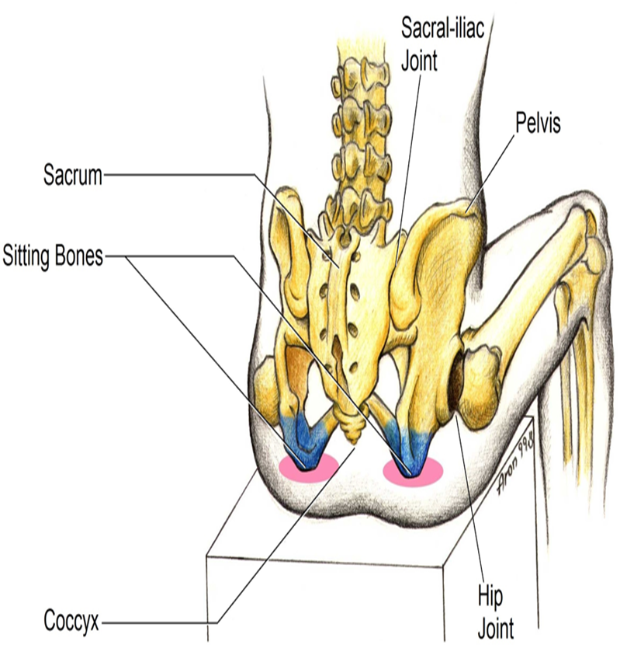
Building the Base Support
What were the outcomes of the MAT assessment?
How do you translate that into the seat support surfaces when considering alternative drive controls:
Create/optimise muscle activate and control
Create support for high fatigue points
Consider access for function
Three or Four points of control
Stacking the spine
Locking the points of control to create function
24hr positioning profile

Slide 6
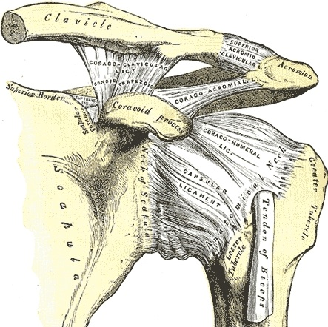
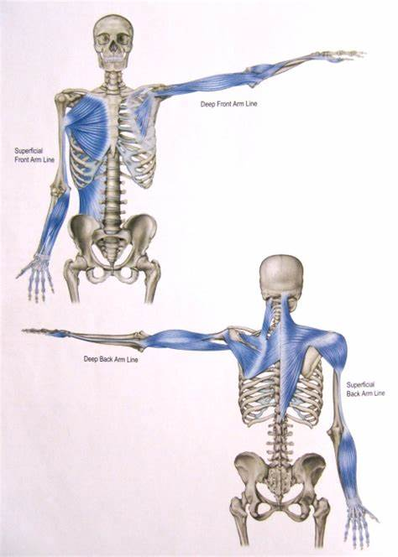
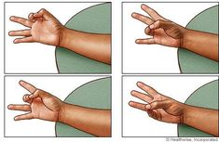
Assessing Controlled Function
Upper Limb Assessment – fine motor/gross motor
Head control
Chin control
Lip control/breath control
Eye tracking
Foot function
Support splints, braces, second skin…

Slide 7
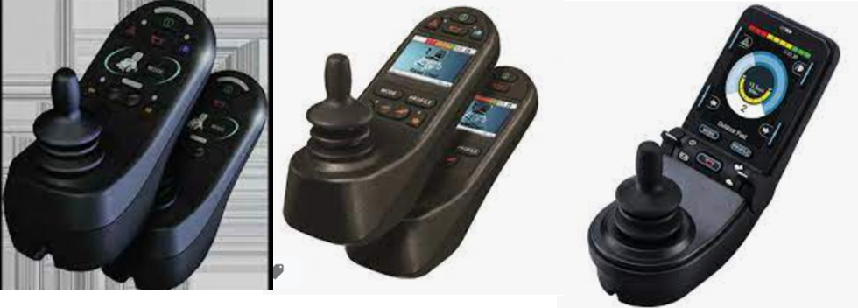
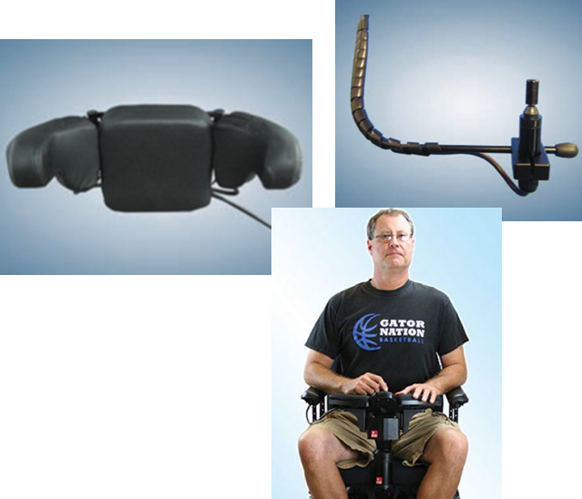
Matching Function to Product Trial
Standard Drive System
Proportional control
With standard joystick / modified joystick
Mounted on armrest
Mode for power functions, drive and environmental controls on controller
Alternate Drive Systems
Different source of control
Placement of systems
Would require additional screen set up
Why use alternate drive system?
To accommodate for client’s needs / ability to drive
Better posture

Slide 8
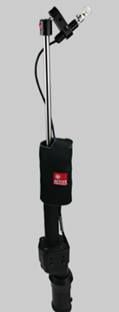
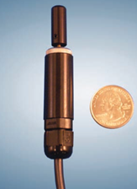
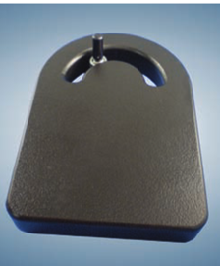
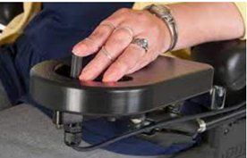
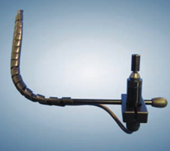
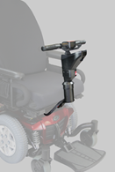
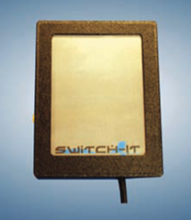
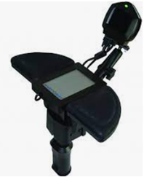
Alternative Drive Systems - Types

Slide 9
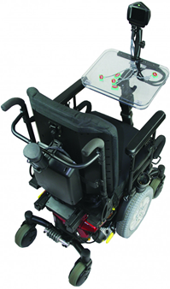
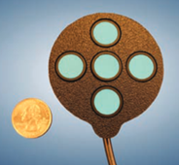
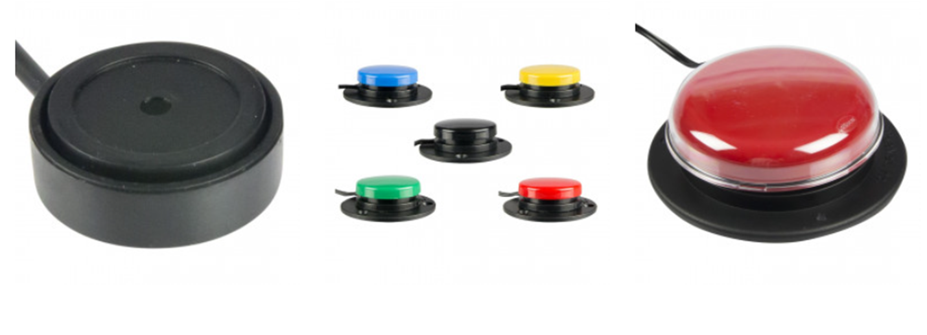
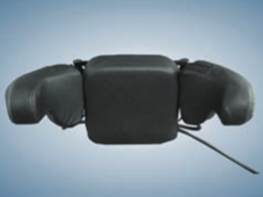
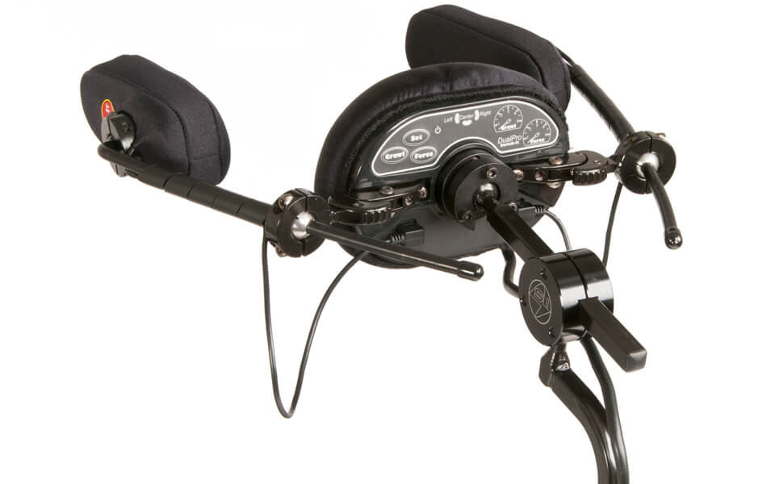
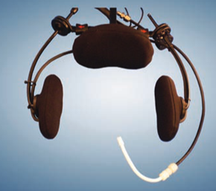
Alternative Drive Systems - Types

Slide 10
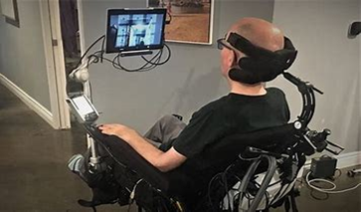
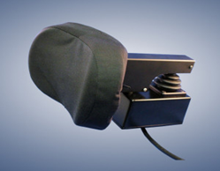
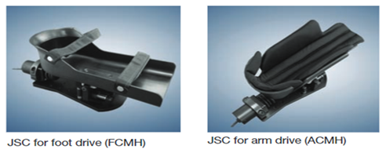
Alternative Drive Systems - Types

Slide 11
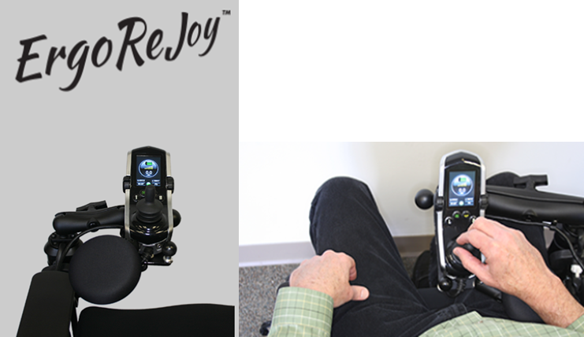
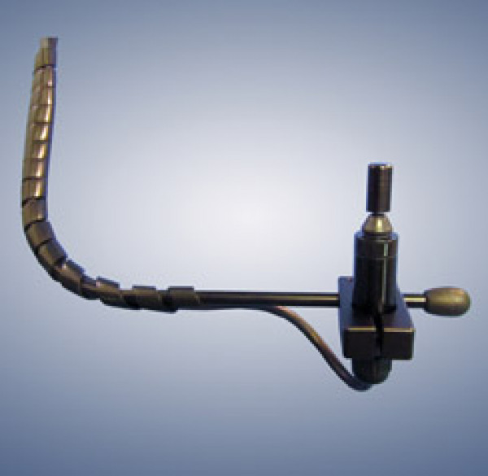
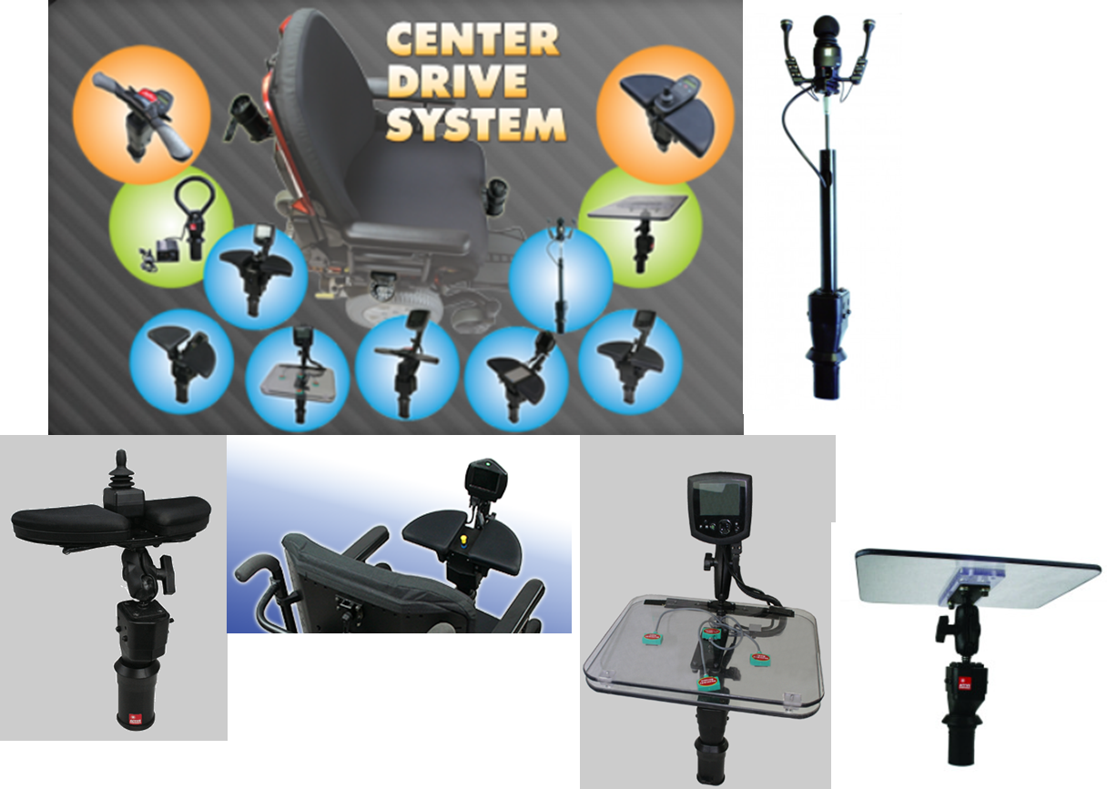
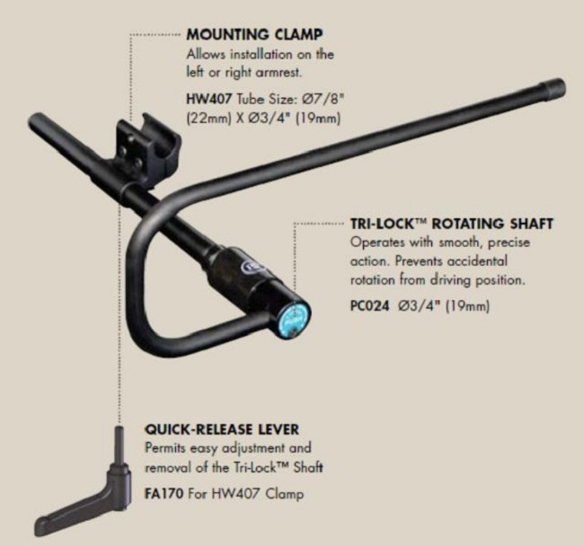
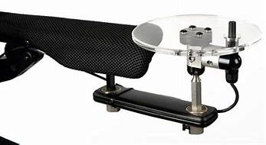
Mounting
Swing away vs removable
Strength
Midline mount
Center drive socket….

Slide 12
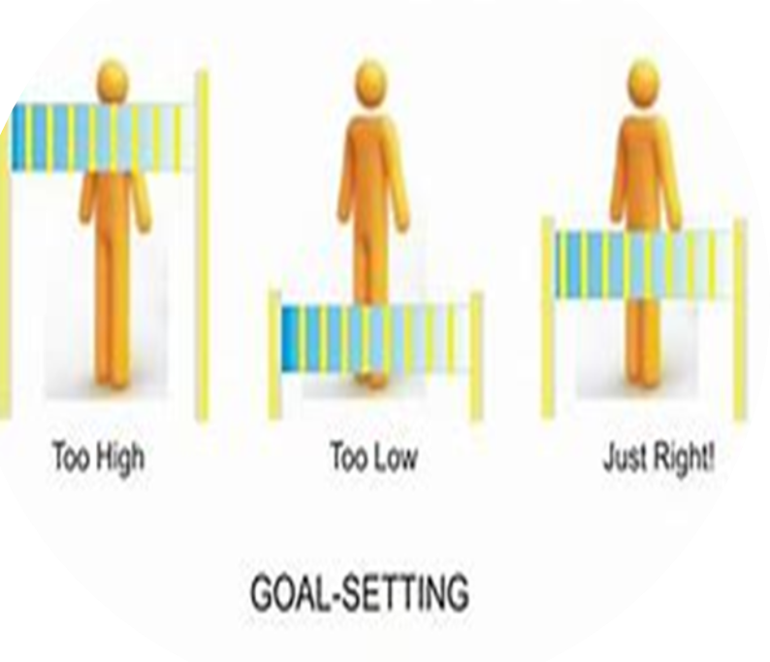
Setting Goals for Mobility & Seating
Collaboration between therapist/s & consumer/their support network
Will it be independent or assisted mobility? Or a combination of both. Will mobility plan be required?
Does the power seating system need to independently accessed? Will memory seating positions be required? Or a combination of both.
Does the seating system need increased postural supports and pressure care?
How does the wheelchair and seating system fit into a 24hr profile?
Identify what daily tasks will be completed by the end user while positioned in the wheelchair (performed independently vs with assistance)
What are the transport requirements?
Short-term vs long-term goals vs goals for trial

Slide 13
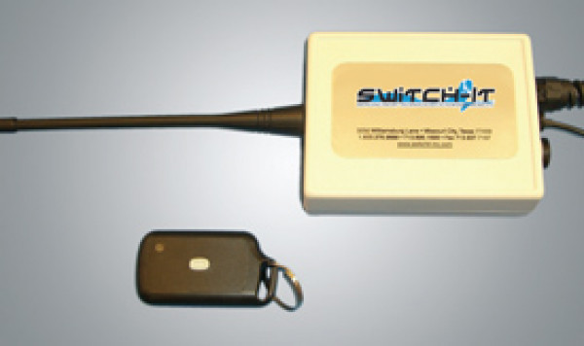
Considerations for Successful Alternate Control Prescription
Complete a comprehensive client profile
Plan to assess and train for successful transfers
Create a base of stability
Have a mobility plan, does it need a remote stop?
Programming!!!! Plan for fine tweaks and reviews
Don’t forget the 24hr positioning

